Slide 1
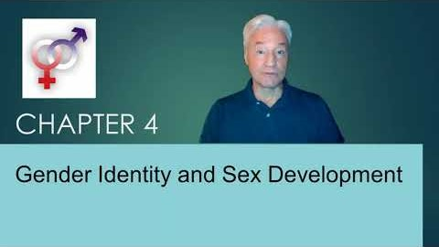

Slide 2
Sex and Gender
Sex: distinct biological, anatomical, and genetic differences of femaleness and maleness (forming the sexes in species that reproduce sexually).
Male, Female, Intersex
Sex assigned at birth is the most inclusive term
Gender: cultural, social, behavioral, and psychological characteristics associated with femaleness and maleness.
Are often used interchangeably but in research have distinct meanings.

Slide 3
Gender Differences
Statistically measurable average difference between females and males.
Are manifested in attitudes and behavior.
Influenced by biology interacting with culture and social experience. Biological influences include:
  Genetics
  Hormones
  Development before and after birth

Slide 4

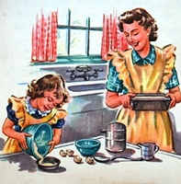
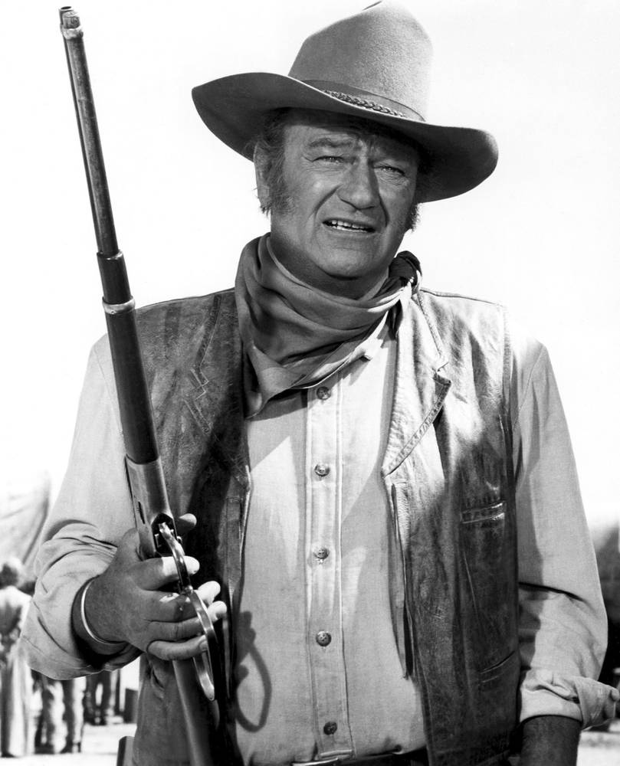

Gender Roles
Describes what a particular culture at a particular time considers desirable behavior for each sex.
Gender role conformity: extent to which an individual’s gendered behavior and identity aligns with the expectations of one’s culture.
Gendered traits rest on foundation of biological sex.
Gender identity: a person’s own sense of femaleness or maleness.

Slide 5
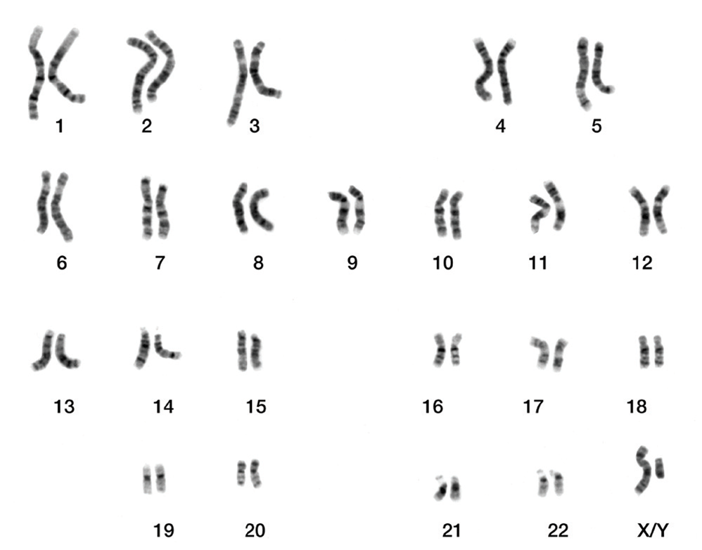
Sex Chromosomes
Males: a long chromosome referred as X and a short chromosome referred as Y.
Females: have two long X chromosomes.

Slide 6
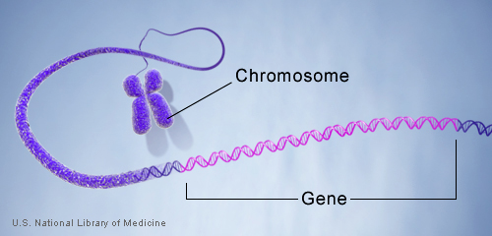
Genes
Genes: small units of genetic information contained on chromosomes
Alleles: variations in a particular gene at a particular location on a chromosome.
G × E interaction (gene by environment interaction): expression of an individual’s genetic potential and predispositions depends in part on the cultural, social, and biological experiences of an individual.

Slide 7





Reproduction of Cells
  Mitosis: individual cells make copies of themselves asexually.
    Forms an exact copy of the original twenty-three pairs of chromosomes that were inherited.
    Errors: can be a source of cell death or lead to disease such as cancer.
    Present in all life on earth.
  Gonads: specialized organs involved in process of reproduction:
    Ovaries in females
    Testes in males
  Sex hormones: signaling chemicals that affect behavior in adults:
    Are produced by gonads
    Affect the development of tissue in fetuses and during puberty

Slide 8
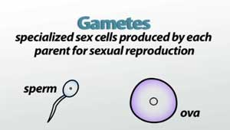
Reproduction of Cells (continued)
  Gametes: specialized reproductive cells containing half the normal number of chromosomes:
    Egg cells in female
    Sperm cells in males
    Produced by gonads
  Meiosis:
    Chromosome pairs are separated.
    Material from one part of a chromosome is swapped and recombined with material from the other chromosome:
      Forms two uniquely different, new chromosomes that end up as single copies in the gametes.

Slide 9
Reproduction of Cells (continued)
Sexual reproduction:
  Results in a greatly accelerated potential for evolutionary change.
  Involves shuffling of genes :
    Genetically linked traits may or may not be passed on to one’s children.
    Leads to greater diversity in offspring.

Slide 10

Biological Sex
Includes six discrete aspects of biology:
  Sex chromosomes
  Gonads
  Internal reproductive structures
  Hormonal sex
  External genitalia
  The nervous system

Slide 11
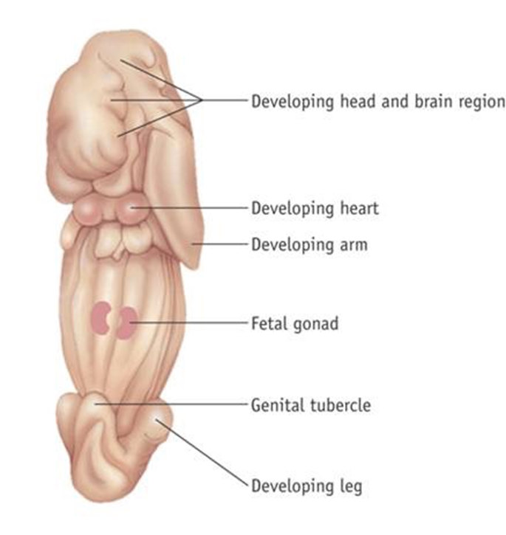
Sexual Differentiation
Biological differences between the sexes include:
  Differences in structure and organization at the level of tissues.
  Differences in activation of tissues.
  These differences are collectively known as sexual dimorphism.
Default pathway of most fetal tissues in mammals is to develop in the female direction.

Slide 12
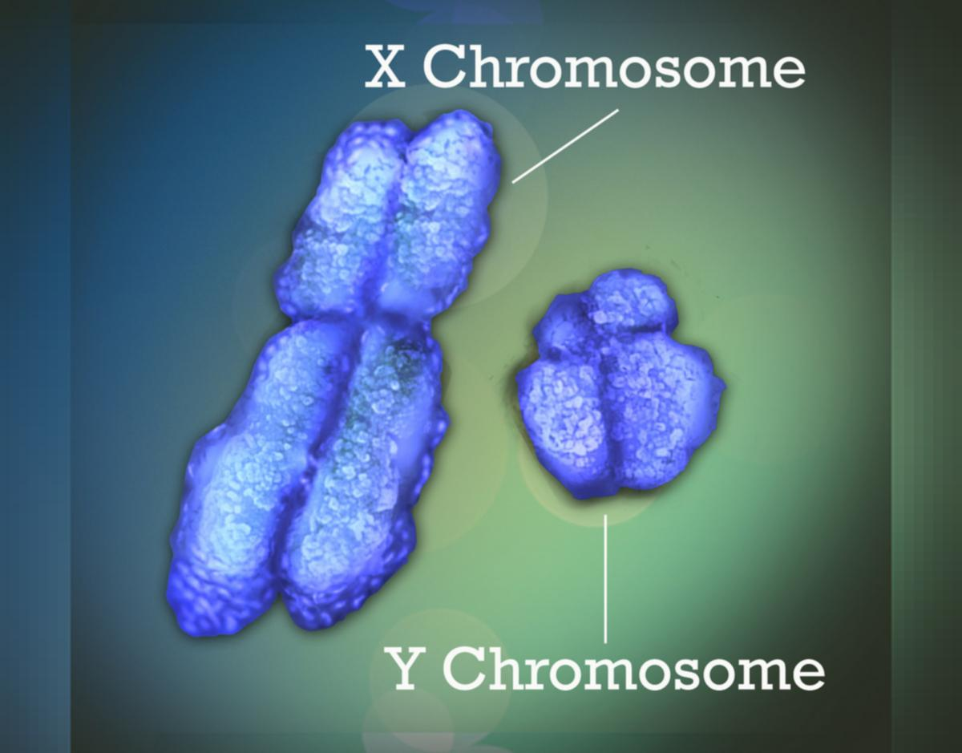
Sex Chromosomes
Female:
  Meiosis results in gametes containing a single X, which is indeed a new remix of genes from the original.
Male:
  Are of different length.
  Do not line up well during meiosis.
  Half of the gametes receive an entire X chromosome and half receive an entire Y chromosome.
Pseudoautosomes are regions on X and Y that receive slightly different X or Y sex chromosome than the original XY.
Sperm cells determine the sex of the future fetus:
  Conceptus: a fertilized egg, prior to development as an implanted embryo.

Slide 13
Sex Chromosomes (continued)
SRY gene:
  Sex-determining region of the Y chromosome.
  Exclusive genetic determinant of biological maleness.
  Genetically XY individuals inheriting:
    A Y chromosome lacking SRY develop as females.
    An X chromosome that carried a mislocated SRY develop as males.
  If absent, causes the gonads to develop into ovaries.
DSS gene:
  Dosage-sensitive sex reversal region.
  Genetically XY individuals with two copies of the DSS region on X chromosome develop as females.
DAX-1 gene:
  A specific gene within the DSS region, on the X chromosome.
  Facilitates the normal development of granulosa cells and ovaries.

Slide 14
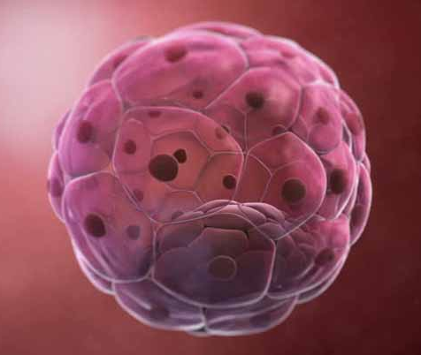
Sexual Development of Reproductive Structures
Blastocyst: formed by continuous division of conceptus and develops into an embryo.
Embryonic stem cells: cells that have the potential to become different types of tissue.
Embryonic layers:
  Ectoderm: skin and nervous system
  Mesoderm: muscles, skeleton, and cardiovascular system
  Endoderm: digestive system and lungs

Slide 15
Reproductive Structures

Slide 16
Sex Hormones
Regulate development of reproductive structures in the fetus.
Made in the body by a series of chemical enzyme reactions from cholesterol, and converted into:
  Progesterone
  Testosterone
Both sexes have both types of sex hormone.
Androgen and estrogen:
  Are both active during fetal development.
  Affect the development of precursor external genitalia into female or male types.
  Influence the development of neurological tissue.

Slide 17
Sexual Development: Genitalia
Starts in the seventh and eighth weeks and is fully complete by the twelfth week.
Distinct genital structures at six weeks:
  Genital tubercle: develops into glans and prepuce:
    Phimosis: A condition where foreskin interferes with passage of urine in infant males
Distinct genital structures at six weeks:
  Urethral fold and urethral groove develop into urethra
  Genital fold:
    Females: develop into labia minora and labioscrotal swelling, which becomes the labia majora in females
    Males: merge with the glans and the labioscrotal swelling becomes the scrotum:
      Hypospadia: abnormal development of the location of the urethral meatus, in males exiting on the shaft of the penis
  Anal pit

Slide 18
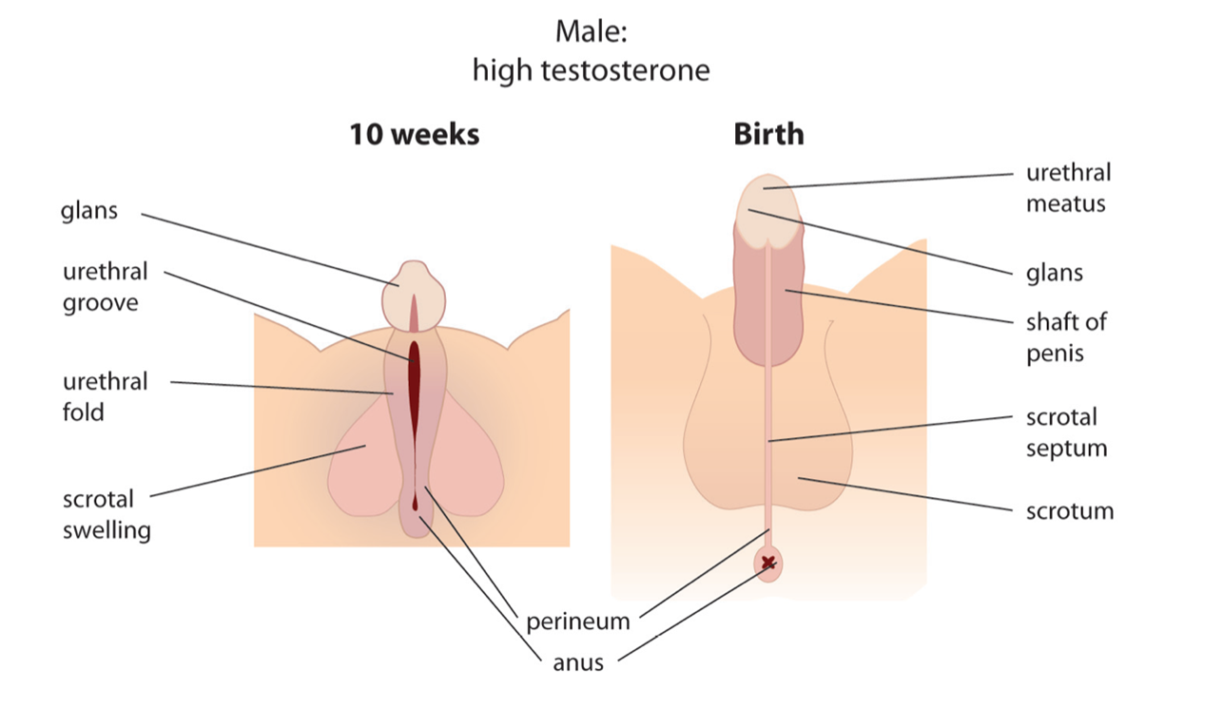
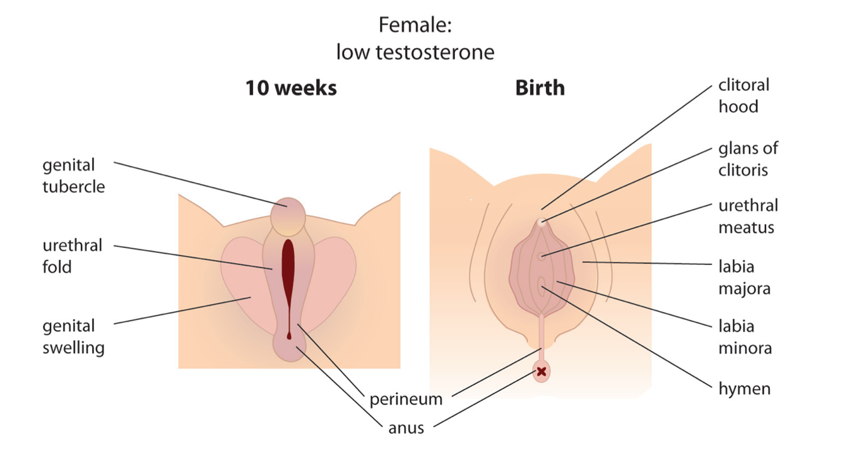
External Genital Structures

Slide 19
Sexual Dimorphism of the Nervous System and Brain
Greater density of genital nerve endings in the clitoris than the glans.
Larger Onuf’s nucleus in males: an area of neurons in the spinal column that controls some muscles in the pelvic floor.
Larger preoptic area of the hypothalamus in males.
Adult females have a larger right hemisphere and adult males have a larger left hemisphere.
Thinner corpus callosum in males.

Slide 20
Gender Differences and the Brain
There are many observed differences between males and females.
Are gender differences due to sex differences in the brain or the cause of sex differences in the brain?
Research reaches diametrically opposing conclusions.
It is difficult to be sure due to methodological challenges as well as discrimination and sexism.

Slide 21
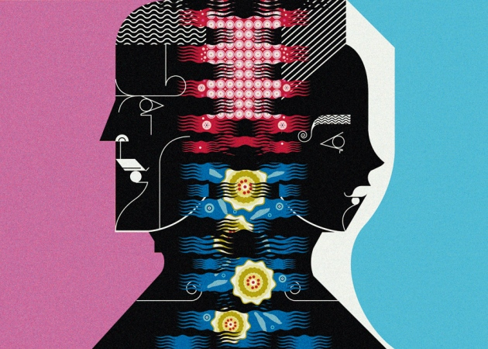
Variations in Sexual Development
Occur in human sexual development due to genetic anomalies.
Disorders of sex development / differences of sex development (DSDs):
  Variations that occur in human sexual development due to genetic anomalies, which used to be referred to as intersex.

Slide 22
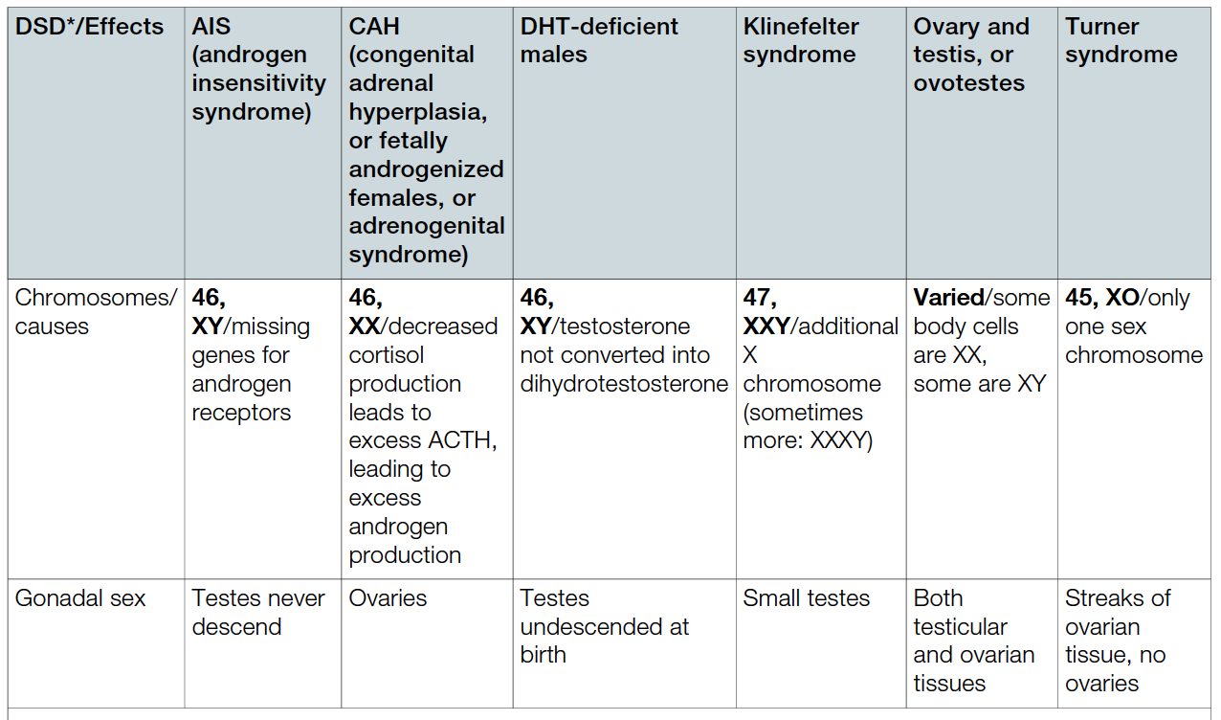
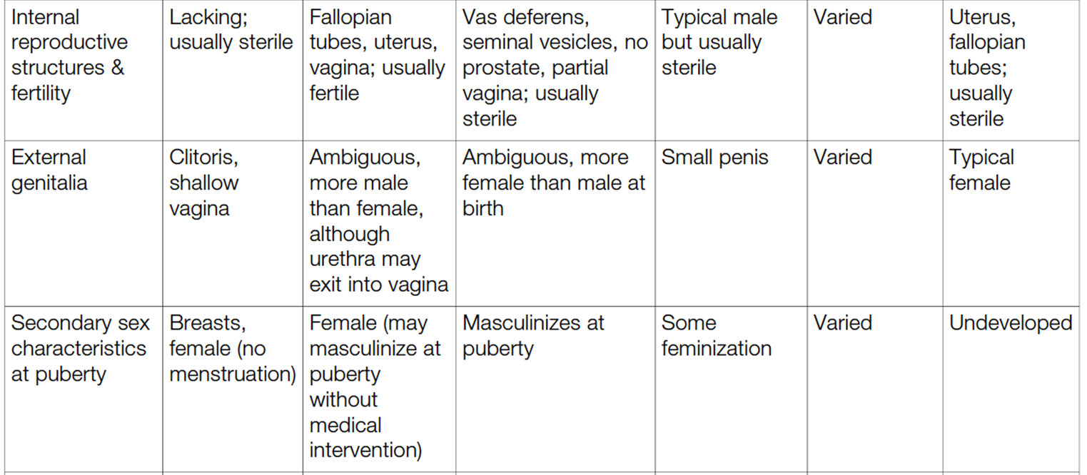
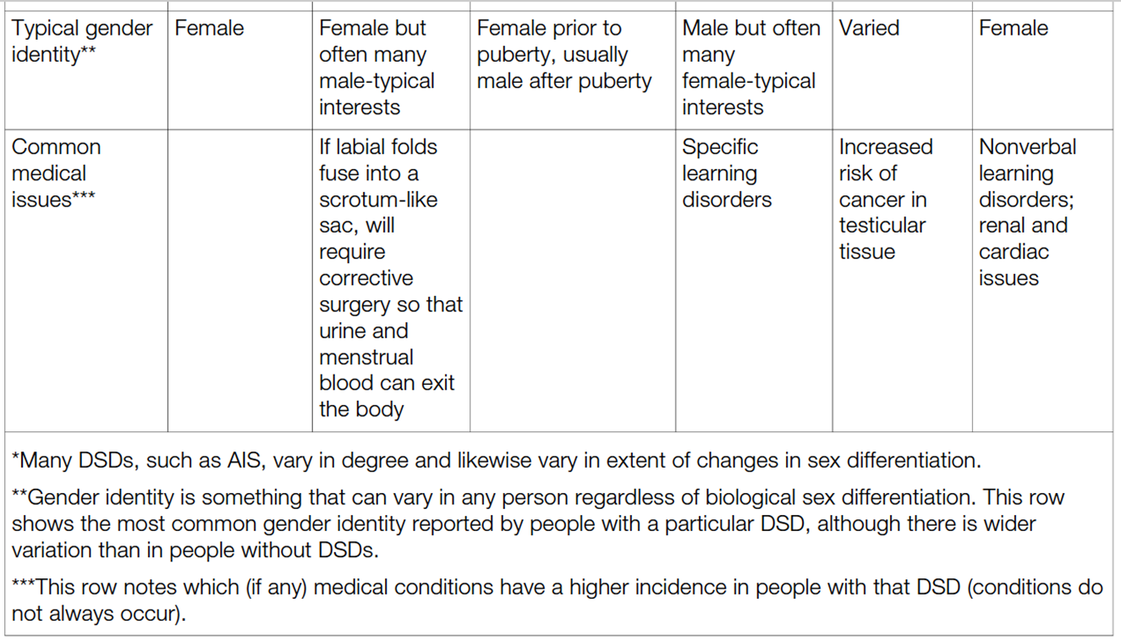
Examples of Sex Differentiation in Six DSDs

Slide 23
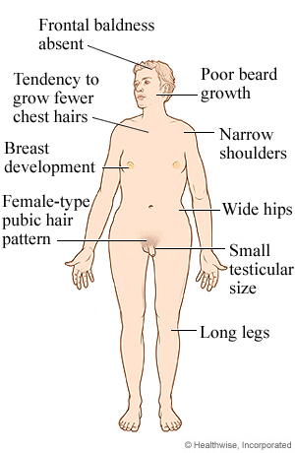
Androgen Insensitivity Syndrome
Androgen Insensitivity Syndrome (AIS) occurs when a chromosomally XY individual is born with:
  Genes having few or no receptor sites for testosterone and DHT.
  Result is that many aspects of biological sex developing as characteristically female.

Slide 24
Congenital Adrenal Hyperplasia
Individuals with congenital adrenal hyperplasia (CAH) are referred to as fetally androgenized females, or as having adrenogenital syndrome.
A chromosomally XX individual with genes causing:
  Excess androgen production, with many aspects of biological sex developing as males.
With medical treatment, a individual would:
  Undergo menarche
  Menstruate
  Develop breasts

Slide 25
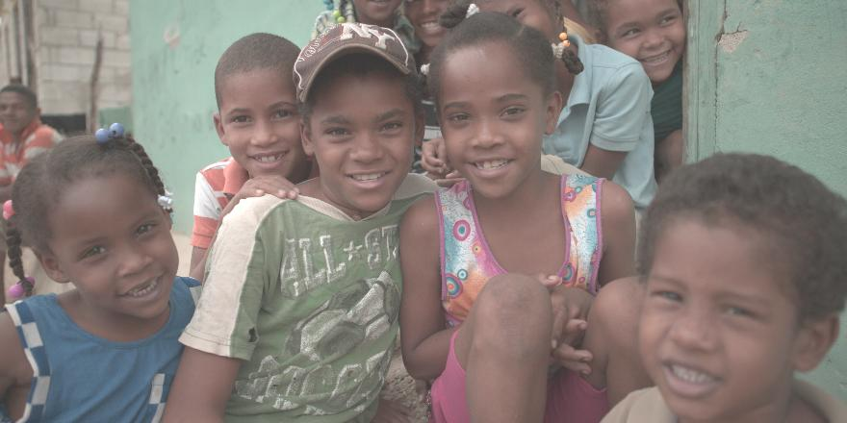
Dht Deficient Males
Have a genetic condition that prevents conversion of testosterone to 5α-dihydrotestosterone.
Have testes but external genitalia are ambiguous.
More female at birth.
May masculinize at puberty, with the external genitalia developing into a penis.

Slide 26
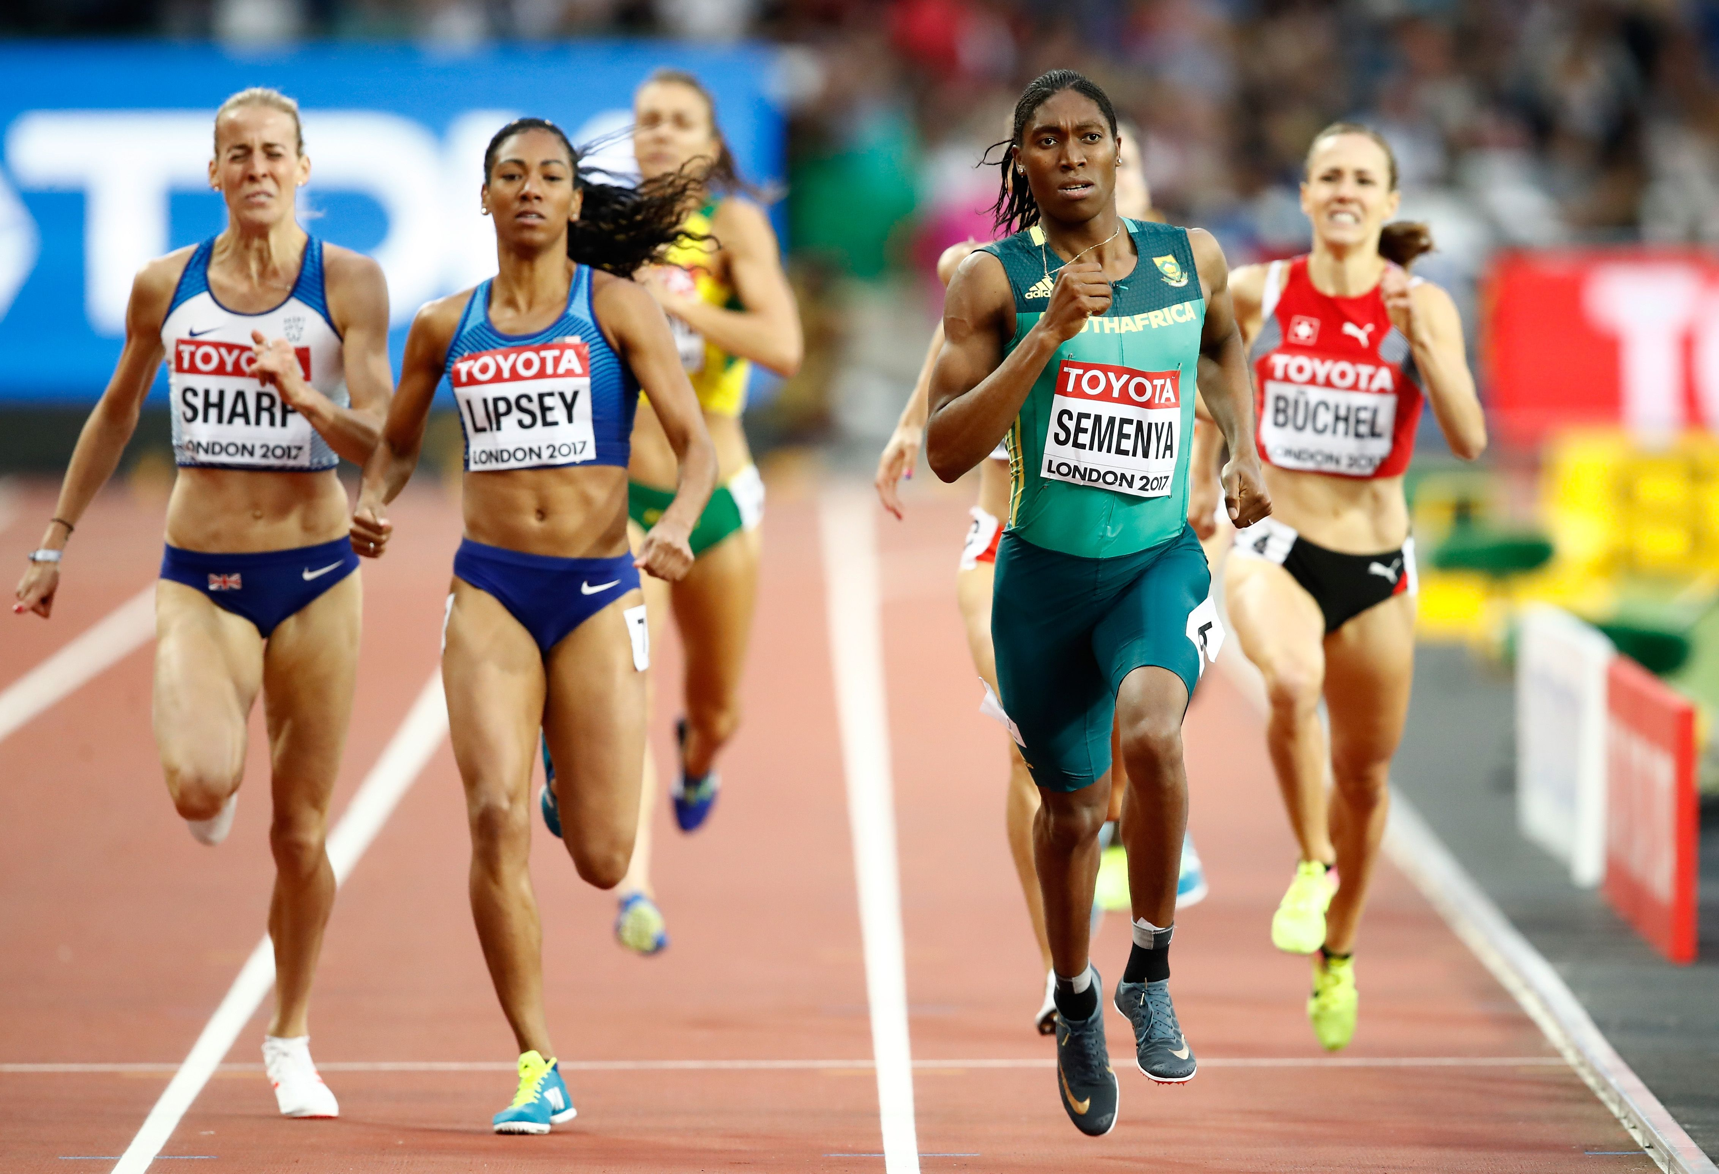
Issues for DSD Individuals
Biological sex and legal meaning:
  Identity documents require picking female or male.
International athletic competitions do not have criteria for whether a person with DSD should compete as female or male.

Slide 27
Issues for DSD individuals
Medical treatment:
  Surgical reduction or removal of the glans.
  Giving sex hormones at puberty to develop the secondary sexual characteristics of the assigned sex.
It is recommended not to assign gender identity in infancy:
  Wait for children to express their innate gender identity.

Slide 28
Research Focus
Reiner, 2004:
  Study on 27 children with cloacal exstrophy (i.e., no penises but were otherwise male).
  25 children were assigned to be females and had their testes removed:
    Exhibited male-typical sex behavior as children, and 14 of them later identified as boys.
  Those 2 raised as boys (without penises) were the best adjusted of the 27.

Slide 29
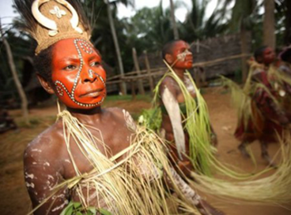
Cross-Cultural Difference in Gender Roles
Cross-culture comparisons show immense differences in:
  Gendered behavior: how people experience being women and men.
  Gender roles: expectations for the sexes.
Ideas associated with sex-typical behaviors have varied across historical eras.

Slide 30
Social Learning and Interactionist Models
Social learning perspective: learning from social environment causes the behavioral and psychological differences ascribed to the sexes:
  Minimizes the role of biology in explaining gender role differences.
  Investigates the role of family environment, peers, media, and the use of language in affecting gender roles.
Interactional model: both biology and social environment cause the behavioral and psychological differences ascribed to the sexes.
Evolutionary psychology: focuses on cognitive mechanisms and processes that evolved through natural and/or sexual selection.
Biologically reductionist: evolved biological differences are most important in explaining gender differences
  Known as essentialist perspective.

Slide 31

Gender Role Conformity
Extent to which one shows gendered characteristics typical of that expected in one’s culture.
Androgyny: exhibiting gendered traits that are typical of both sexes.
Gender role nonconforming: showing traits primarily associated with the other sex.
Cultures vary in the extent to which they encourage, tolerate, or discourage gender role conformity.

Slide 32
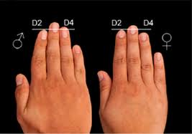
Gender Role Conformity
Individual differences have been linked to differences in biological sex development.
2D:4D ratio: measure the length of the index finger and divide it by the length of the ring finger:
  Believed by some to have been influenced by prenatal exposure to sex hormones.
  Lower the ratio:
    Greater the exposure to androgens.
    Higher the correlation for that individual person to exhibit male sex-typical gender role behavior.
  Correlated with sexual orientation.

Slide 33
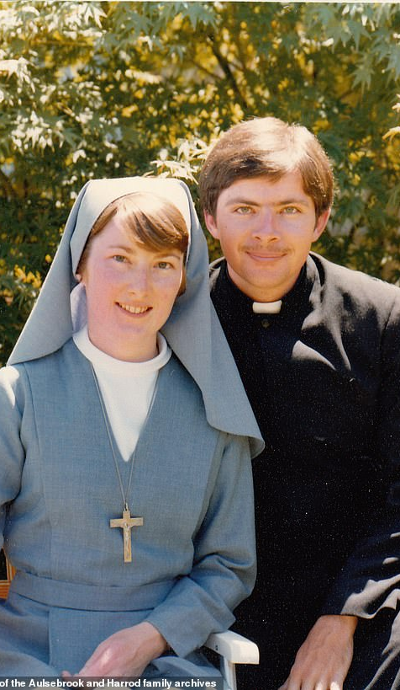
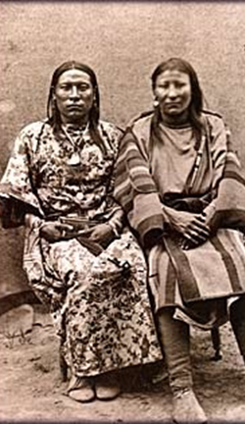
Religion and Gender
Traditional interpretations:
  Clear distinctions between male and female behavior in both personal and religious practice.
  Encourage conformity.
Liberal interpretation:
  Have traditions with more equal gender roles.
Two-spirit person: individuals who do not conform to those clear gender roles.

Slide 34
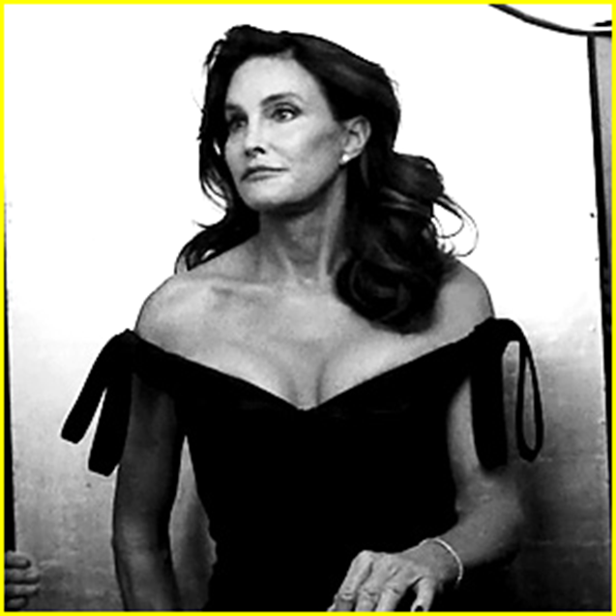
Transgender and Variations in Identity
Transgender: differ in gender identity, gendered behavior, and/or sexual orientation:
  Culturally specific combination of six interrelated dimensions of sexuality:
    Biological sex
    Gender role conformity
    Gender identity
    Gendered appearance
    Gendered behavior
    Sexual orientation

Slide 35
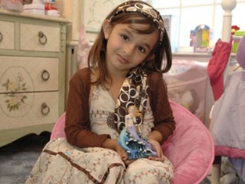
Transgender
Transgender: People whose gender identity differs from their genetic and anatomical sex
May express their gender in early childhood.
Likely explanation for transgender identity:
  Sexual differentiation of the brain occurs in a direction different from anatomical sex.

Slide 36
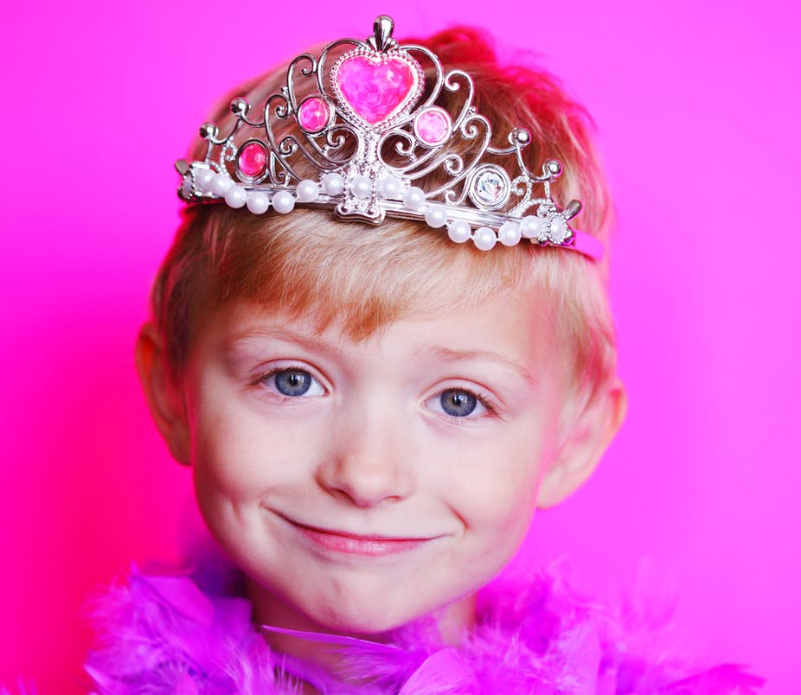
Gender Dysphoria
Incongruence between gender identity and sex assigned or assumed at birth.
Formerly known as Gender Identity Disorder in DSM-IV-TR.

Slide 37


Gender Affirmation
Administering sex hormones:
  Develops some of the secondary sexual characteristics.
Gender-affirming surgery:
  Anatomical sexual characteristics such as breasts and genitalia are altered to be congruent with the person’s gender identity
  Previously referred to as sexual reassignment surgery (SRS).

Slide 38
Transitioning
Transitioning: the process for transgender people of making aspects of outward sex align with their gender identity
Various self-identification terms:
  Transman: gender identity is male but was assigned female at birth.
  Transwoman: gender identity is female but was assigned male at birth.
  Cis (cisgender): nontransgender person whose gender identity aligns with gender assigned at birth.
  Genderqueer: indicates a variety of identities other than a rigid female-male binary.
  Autogynephilic: being erotically aroused at the idea of becoming a woman.

Slide 39
Transitioning in Childhood
Requires careful evaluation to confirm diagnosis of gender dysphoria.
Involves medically suppressing puberty to delay the development of secondary sex characteristics:
  Reduces the amount of surgery.
  Gives enough time to cognitively weight the potential medical consequences.
Older adolescent or young adult may chose to have:
  Gonads removed.
  Sex hormones administered.

Slide 40


Transitioning in Adulthood
Requires psychiatric or psychological evaluation to ensure that the person has gender dysphoria.
Real-life experience: period of six months to 2 years, during which transgender individuals seeking gender-affirming surgery are required to live expressing gendered behaviors typical of their gender identity.

Slide 41
Genital Reassignment
Involves genital surgery
Has higher risk of reduced sensation that may make it difficult for a person to have orgasms
Vaginoplasty: constructing both a vagina and a vulva
Phalloplasty: constructing penis
Metoidioplasty: involves construction of a scrotum and testicular implants, with hormones used to enlarges clitoris into small penis

Slide 42
Vaginoplasty, Phalloplasty, and Metoidioplasty

Slide 43
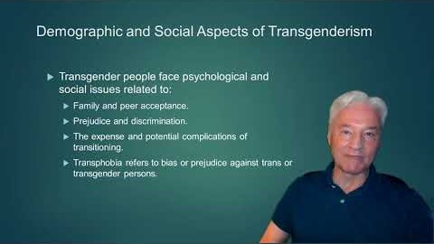

Slide 44
Demographic and Social Aspects of Transgenderism
Transgender people face psychological and social issues related to:
  Family and peer acceptance.
  Prejudice and discrimination.
  The expense and potential complications of transitioning.
  Transphobia refers to bias or prejudice against trans or transgender persons.

